Slide 1

John Harker
Competency Portfolio
www.infratec-uk.com

Slide 2
Competency Summary
Category | Accreditation Body | No. | Expiry
Lorry Loader – Capacity up to: Unlimited Categories: D1+D2+D3+E | ALLMI | 260912 | 05/04/2029
Slinger/Signaller | ALLMI | 224236 | 23/04/2027
IPAF (1B, 3A, 3B) | IPAF | OP/1926912 | 31/01/2026
National Highways Safety Passport Common Induction | National Highways | 14-000550443 | 02/05/2027
Lift Supervisor | CPCS | 40041036 | 31/06/2029
www.infratec-uk.com

Slide 3
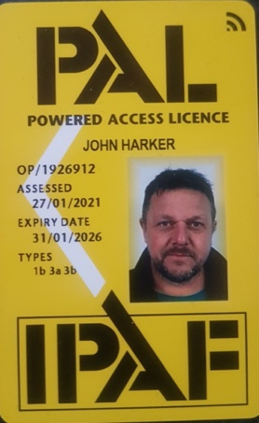
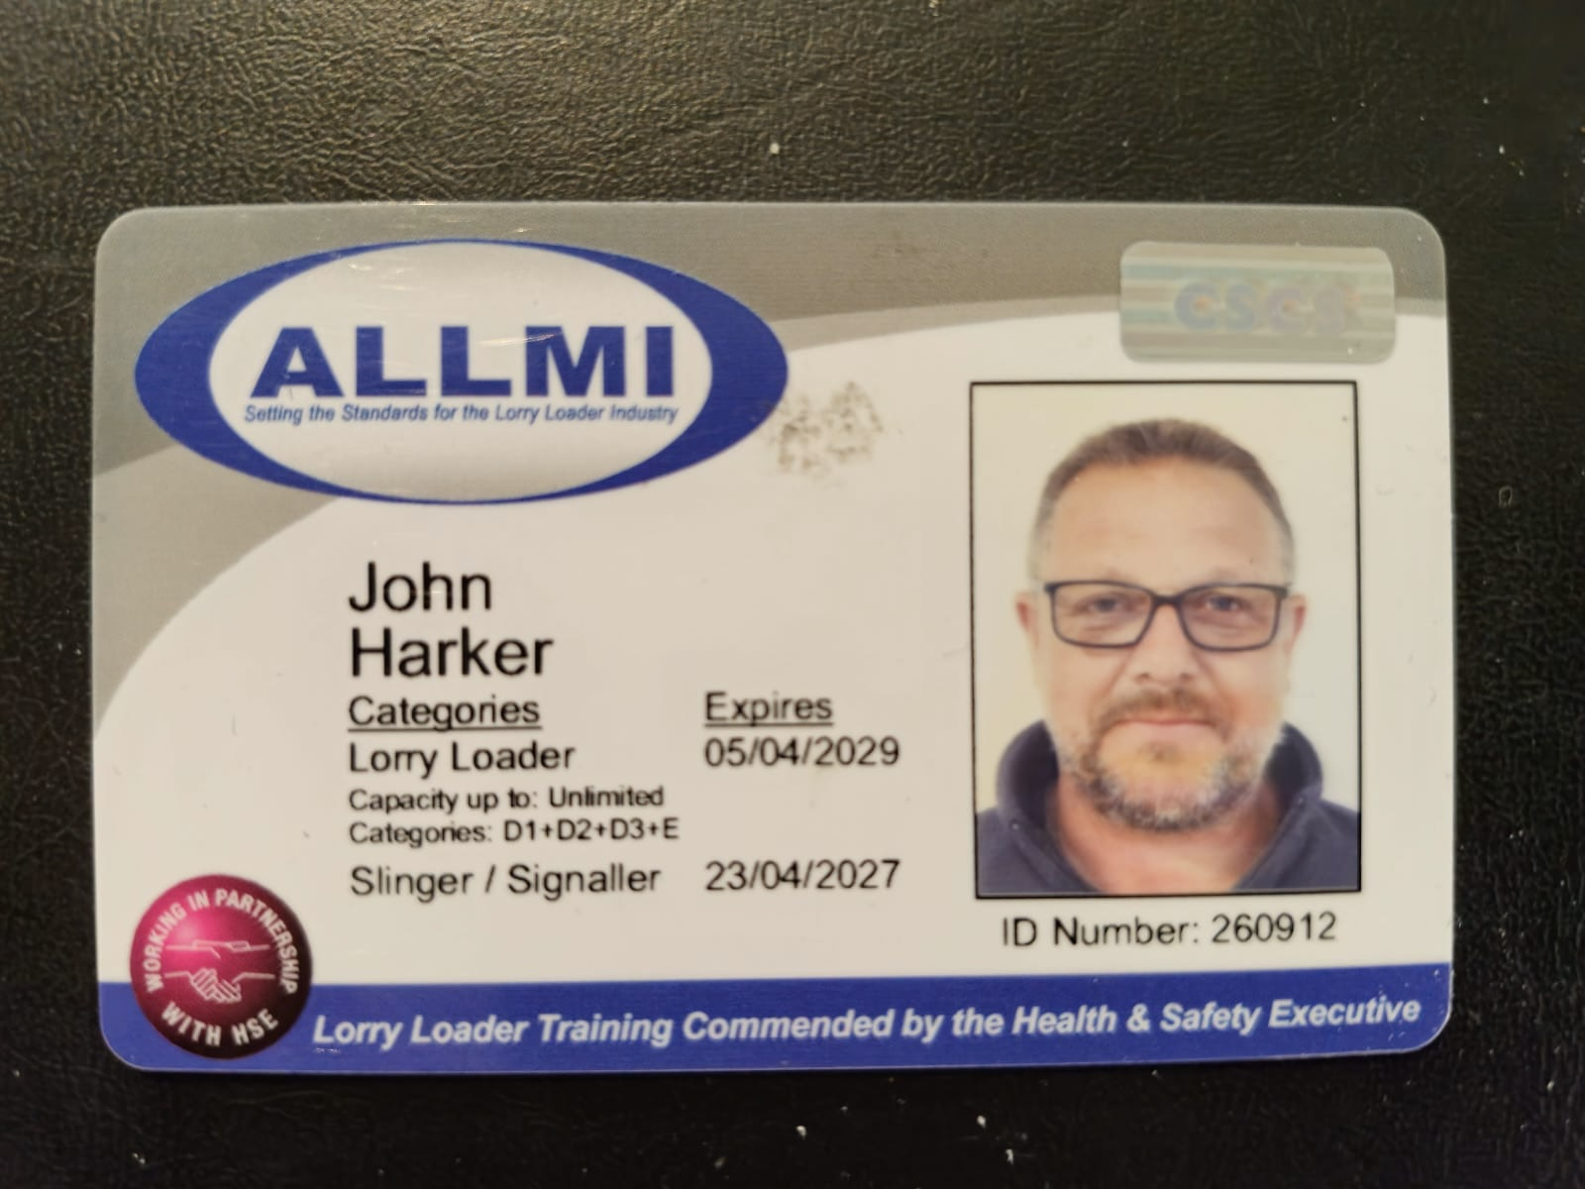
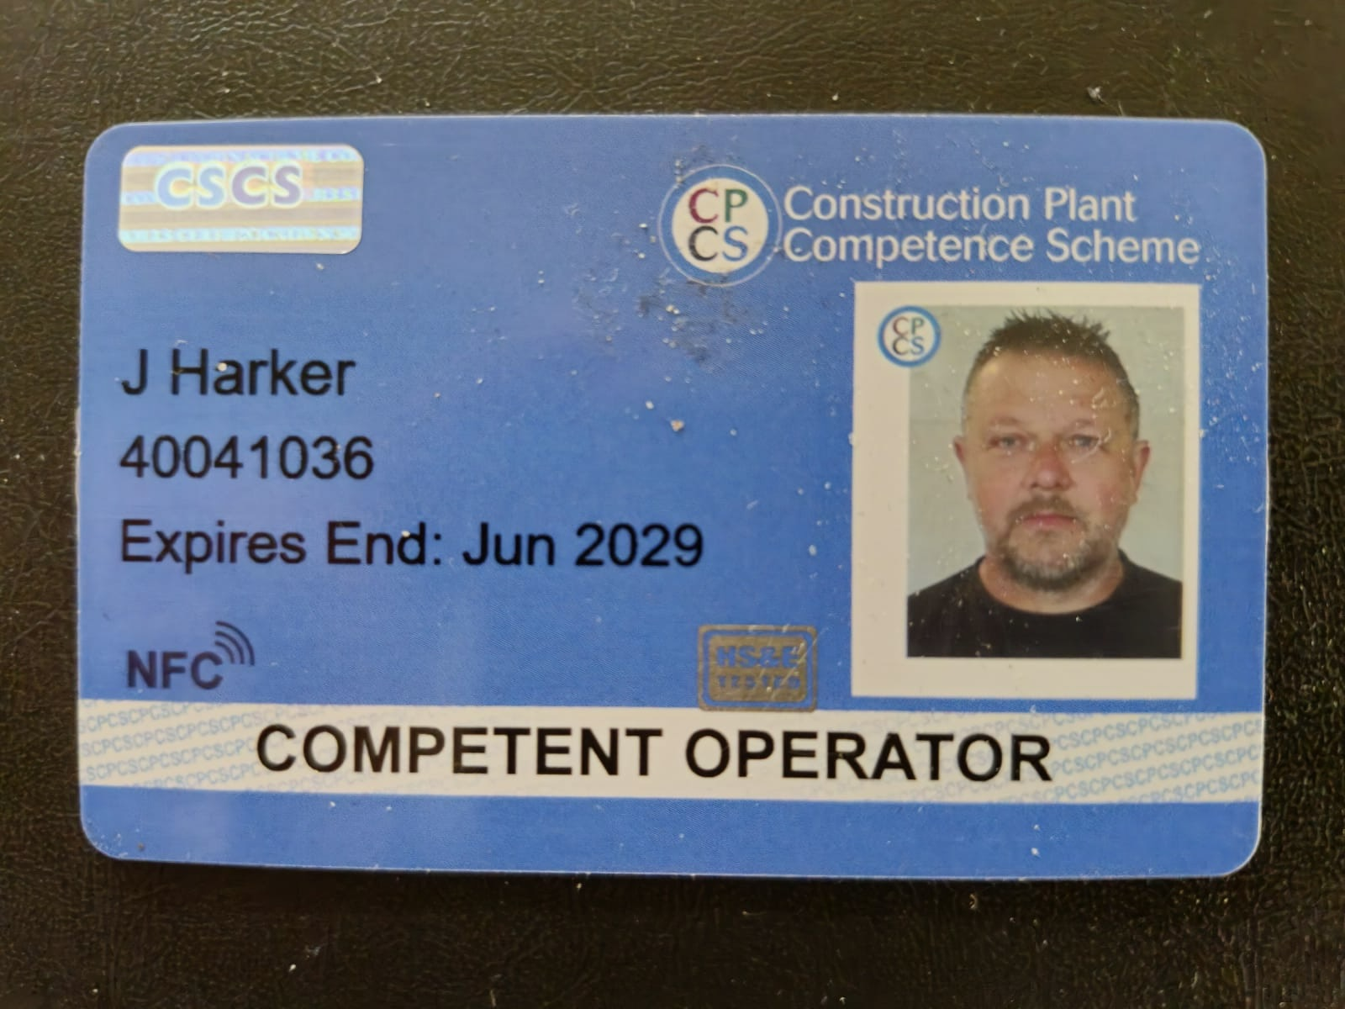
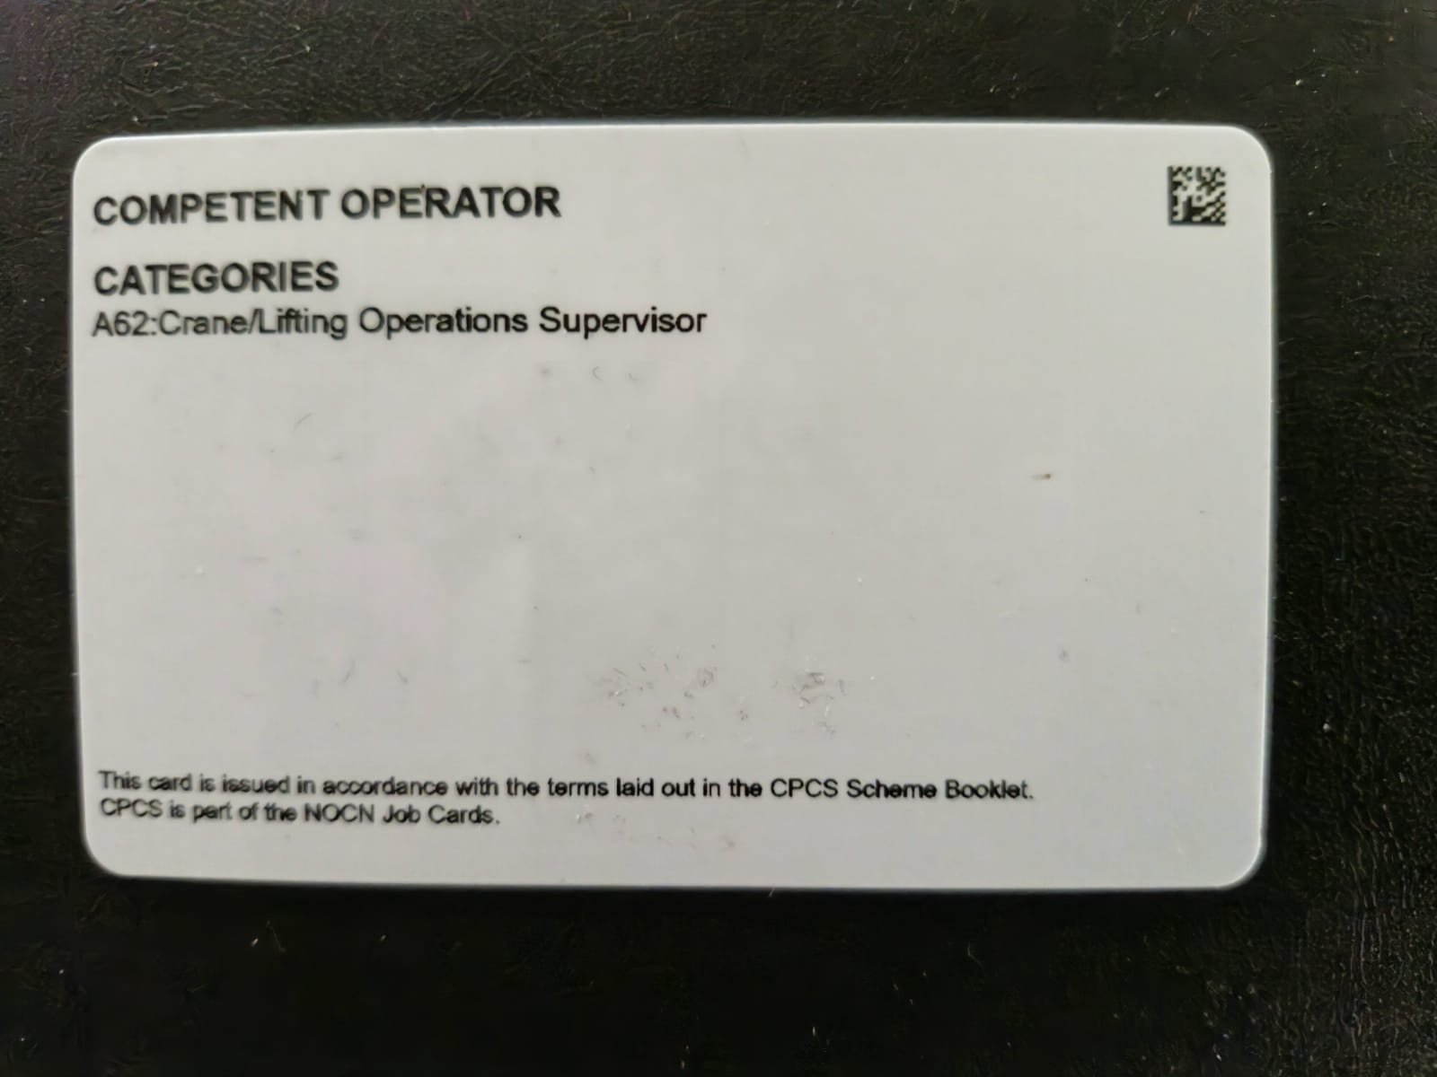
Competency Cards
IPAF
ALLMI
CPCS
www.infratec-uk.com

Slide 4
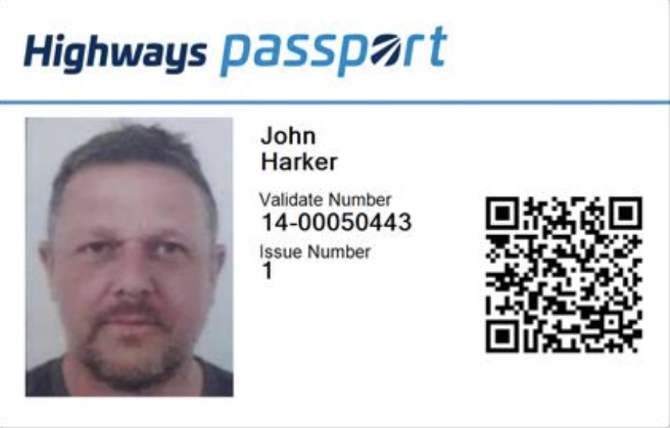
Competency Cards
Highways Passport

